Slide 1
Supporting legislators who support YOUR hospital.
Notes:
Goal: $125,000
All IHA members hospitals and health systems contributing - we surpass the goal.

Slide 2
Member Contributions and Resulting Candidate Support
Contributions or gifts to the IHA PAC are not deductible as charitable contributions for tax purposes. All contributions are voluntary and have no impact on your job status, performance review, compensation or employment. Any giving guidance is merely a suggestion. Any amount given or the decision not to give will not advantage or disadvantage you. Federal law requires us to use our best efforts to collect and report the name, mailing address, occupation and name of employer of individuals whose contributions exceed $200 in a calendar year January-December.
Notes:
Declines in member contributions directly correlate to having to pull back on support of candidates, party leaders and the governor.

Slide 3
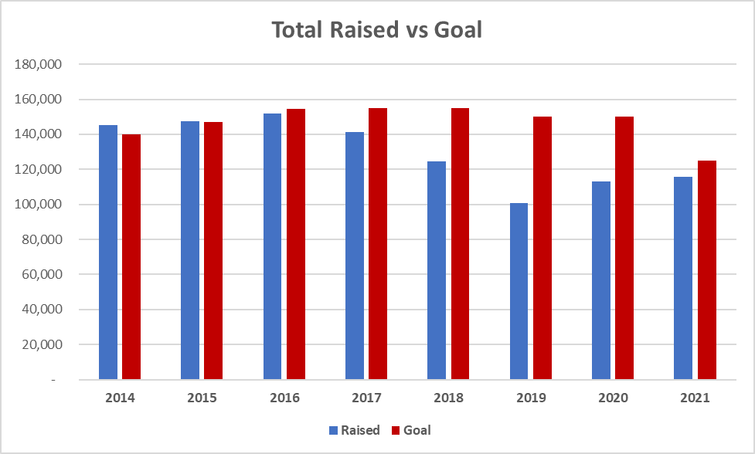
IHA PAC Total Raised vs. Goal
Contributions or gifts to the IHA PAC are not deductible as charitable contributions for tax purposes. All contributions are voluntary and have no impact on your job status, performance review, compensation or employment. Any giving guidance is merely a suggestion. Any amount given or the decision not to give will not advantage or disadvantage you. Federal law requires us to use our best efforts to collect and report the name, mailing address, occupation and name of employer of individuals whose contributions exceed $200 in a calendar year January-December.
Notes:
Slipping in meeting the goal over the high of $151,000 in 2016.
Nearly met it last year when it was lowered to $125,000 by the IHA PAC Committee .

Slide 4
How the IHA PAC measures up
Ranking | Political Action Committee | 2021 Contributions
1 | Republican Party of Iowa | $1,156,244
2 | Credit Union PAC | $1,121,235
3 | Iowa Democratic Party | $940,654
4 | RPAC Iowa - REALTORS Political Action Committee | $438,253
5 | Iowa State Education PAC (ISEA) | $418,753
6 | Association General Contractors of Iowa (AGC) | $341,717
7 | Hy-Vee, Inc. Employees' Political Action Committee | $273,675
8 | Iowa Health PAC | $272,113
9 | Berkshire Hathaway Energy Company | $209,061
10 | Bankers Unite | $187,572
11 | Iowa Farm Bureau | $148,296
12 | Master Builders of Iowa | $133,269
13 | Heavy Highway Political Action Committee | $129,416
14 | Polk County Democratic Central Committee | $119,297
15 | IHA PAC | $115,648
*Nursing homes have a constant distribution process and replenish continuously. IHA holds funds until election cycles.
Contributions or gifts to the IHA PAC are not deductible as charitable contributions for tax purposes. All contributions are voluntary and have no impact on your job status, performance review, compensation or employment. Any giving guidance is merely a suggestion. Any amount given or the decision not to give will not advantage or disadvantage you. Federal law requires us to use our best efforts to collect and report the name, mailing address, occupation and name of employer of individuals whose contributions exceed $200 in a calendar year January-December.
Notes:
Note - Nursing home industry (Iowa Health PAC) - more than double

Slide 5
How the IHA PAC measures up
 | IHA PAC | Wellmark, Inc. PAC | Iowa Health PAC | Iowa Dental PAC | Iowa Medical Society
Legislative Leadership | $3,000 | $12,000 | $80,500 | $4,000 | $2,500
Governor | $0 | $2,500 | $30,000 | $2,000 | $0
Human Resources Leadership | $1,000 | $2,500 | $34,250 | $1,750 | $1,000
HHS Subcommittee Leadership | $500 | $200 | $23,500 | $1,750 | $1,000
 | IHA PAC | Wellmark | Nursing Homes | Farm Bureau
*Information is based on calendar year 2021
*Some legislators serve on both the Human Resources Comm. and the HHS Subcomm. resulting in their contributions counting twice.
Contributions or gifts to the IHA PAC are not deductible as charitable contributions for tax purposes. All contributions are voluntary and have no impact on your job status, performance review, compensation or employment. Any giving guidance is merely a suggestion. Any amount given or the decision not to give will not advantage or disadvantage you. Federal law requires us to use our best efforts to collect and report the name, mailing address, occupation and name of employer of individuals whose contributions exceed $200 in a calendar year January-December.
Notes:
Traditionally, IHA PAC contributions are less in non-election years, saving funds to support candidates in election years.
IHA PAC has focused on grassroots work.
IHA PAC donates healthy amounts of funds to a broad range of legislators rather than very large amounts to a small amount of legislators.
In 2018, the IHA PAC contributed $44,000 to legislative leadership. Less in 2020 given the impact of he COVID-19 pandemic

Slide 6
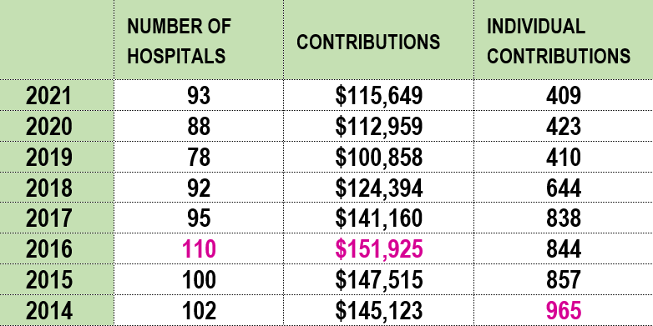
Hospital and Individual Trend Chart
Contributions or gifts to the IHA PAC are not deductible as charitable contributions for tax purposes. All contributions are voluntary and have no impact on your job status, performance review, compensation or employment. Any giving guidance is merely a suggestion. Any amount given or the decision not to give will not advantage or disadvantage you. Federal law requires us to use our best efforts to collect and report the name, mailing address, occupation and name of employer of individuals whose contributions exceed $200 in a calendar year January-December.

Slide 7
Current Statewide Total
$84,303* (67% of $125,000 goal)
67 hospitals
4 health systems
214 individuals
Campaign deadline: Sept. 30
*as of Aug. 15
Contributions or gifts to the IHA PAC are not deductible as charitable contributions for tax purposes. All contributions are voluntary and have no impact on your job status, performance review, compensation or employment. Any giving guidance is merely a suggestion. Any amount given or the decision not to give will not advantage or disadvantage you. Federal law requires us to use our best efforts to collect and report the name, mailing address, occupation and name of employer of individuals whose contributions exceed $200 in a calendar year January-December.
Notes:
Individuals to date: 206
total contributions - $80,268
comparison to last year at this time - $58,275.01
IHA staff raised $21,475 in 2021 campaign. The most money ever raised by an organization’s campaign since the PAC started in 1990.

Slide 8
General Election November 8th
Goal – elect hospital CHAMPIONS!
6 open Senate races
32 open House races
Five candidates have hospital/health care experience
Notes:
JK

Slide 9
Top issues for IHA Members
Workforce
Tort reform
Medicaid
Certificate of Need
Behavioral health
Pharmacy issues (PBMs + 340B)
Maternal health / lay midwives

Slide 10
Investing in the IHA PAC ensures Iowa hospitals have a strong voice at the Capitol!

Slide 11
Donate Online Today
This QR code goes directly to the IHA website login page. Then after login, directly to the IHA PAC Donation page.
On IHA’s website: https://my.ihaonline.org/Donate-PAC
On PayPal:
CEOs/Trustees - https://www.paypal.com/donate?hosted_button_id=5WRXGTUJLUPJE
Donation amounts: $2,500 / $1,000 / $750 / Other
Physicians/Senior Directors - https://www.paypal.com/donate?hosted_button_id=ADZE32FFQXY28
Donation amounts: $500 / $350 /$250 / Other
Directors/Managers - https://www.paypal.com/donate?hosted_button_id=2ULPQA9PGTVS8
Donation amounts: $100 / $75 / $50 / Other
Contributions or gifts to the IHA PAC are not deductible as charitable contributions for tax purposes. All contributions are voluntary and have no impact on your job status, performance review, compensation or employment. Any giving guidance is merely a suggestion. Any amount given or the decision not to give will not advantage or disadvantage you. Federal law requires us to use our best efforts to collect and report the name, mailing address, occupation and name of employer of individuals whose contributions exceed $200 in a calendar year January-December.

