Slide 1
Patient Care Management for Critical Care Patients
MercyOne-Des Moines
Critical Care Service Line
Julie Tuel, MSN, RN, CCRN-CMC, SCRN
Market Director of Critical Care Services
Brad Wilson,
Director of Respiratory Therapy

Slide 2
Standards of Care for Critical Care Patients
ABCDEF bundle
A, B, C=Awakening and Breathing Coordination
D=Delirium Identification and Management
E=Early Mobility
F=Family
*
‹#›
Notes:
‹#›

Slide 3
Standards of Care for Critical Care Patients
Full body assessment every 4 hours
Vitals every hour
If unstable or titrating medications, increase to Q15 minutes
Goal MAP 65 or greater
Head of Bed at 30 degrees at all times
If NPO, oral care every 4 hours and provide oral suctioning as needed
Decrease risk of aspiration pneumonia
Turn patient every 2 hours
Elevate heels
Off load weight off coccyx
Assess skin every 2 hours for breakdown, deep tissue injury
*
‹#›
Notes:
‹#›

Slide 4
Standards of Care for Critical Care Patients
Blood Sugar Q4 hours
Goal BS less than 180
Sliding scale
If blood sugar greater than 180 x 2 checks in 24 hours, initiate insulin gtt
Initiate tube feedings within 24 hours of intubation
NG
Check placement Q4 hours
Confirmation via KUB, not auscultation
Foley if intubated
Pericare every 4 hours
GI prophylaxis
Pepcid 20 mg BID
DVT prophylaxis
Lovenox/Heparin
SCD stockings
*
‹#›
Notes:
‹#›

Slide 5
Standards of Care for Critical Care Patients
Restraints
Order must be renewed every 24 hours
Restraint checks every 2 hours
*
‹#›
Notes:
‹#›

Slide 6
ABC
Awake and Breathing Coordination
Goal for as little time on ventilator as possible
Assess for vent weaning trial daily
Goal SPO2 90% or greater
Covid-okay with sats in the 80s
Need to fully allow assess patient
*
‹#›
Notes:
‹#›

Slide 7
RASS
RASS assessment with 2 hours if sedated
Goal 0
*
‹#›
Notes:
‹#›

Slide 8
CPOT
Assess Q4 hours and PRN
*
‹#›
Notes:
‹#›

Slide 9
Sedation Management
No benzos
Assess for pain first
Manage with Propofol
Must have designated IV site for Propofol
Gtt is weight based
Start gtt at 10 mcg/kg/min and titrate by 5 mcg/kg/min every 5 minutes until goal RASS is reached
Titrate as able, less is more
For RASS +3 or +4, bolus with 0.2-0.4 mg/kg every 5 minutes, max 2 doses per episode of agitation. For decreased agitation, reduce dose by 5-10 mcg/kg/min every 30 minutes. Attempt dose reduction once every 4 hours with assessment
Risk is hypotension, if experienced, wean down gtt and reassess RASS
Contraindications: high triglycerides
*
‹#›
Notes:
‹#›

Slide 10
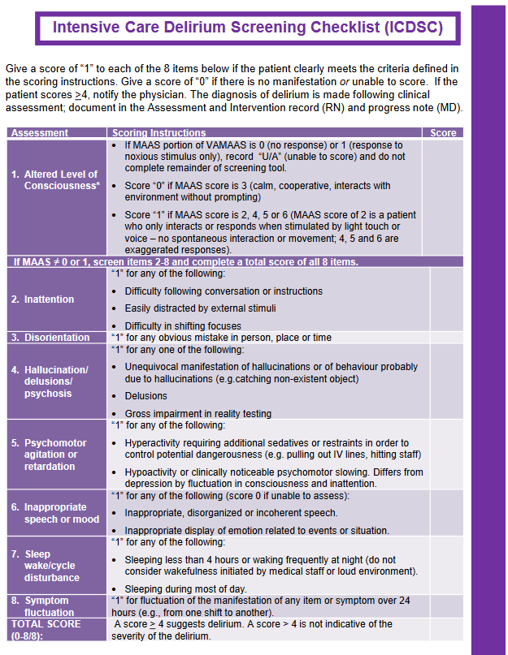
Delirium Management
Assess Q 12 hours
*
‹#›
Notes:
‹#›

Slide 11
D=Delirium Prevention
2 types:
Hyperactive
Hypoactive
Mixed
No approved treatment, prevention is best
Maintain day and night environments
Nights: Lights off, decrease stimulation
Days: lights on
Limit sedation as much as possible
*
‹#›
Notes:
‹#›

Slide 12
Early Mobility
Increase mobility as able
*
‹#›

Slide 13
F=Family Presence
Increase presence
Better outcomes for patient and family
*
‹#›
Notes:
‹#›

Slide 14
Additional Airway Management Resources
Airvo/Vapotherm
Risk for silent aspiration if flow greater than 40 liters
Swallow evaluation, FEES study
May need enteral nutrition
Proning
Non intubated-encourage patient to self prone
Intubated-requires at least 4 health care providers (one provider)
16 hours proned and then unprone
Reposition head every hour while proned and turn patient every 2 hours
*
‹#›

Slide 15
Questions
*
‹#›
Notes:
‹#›

Slide 16
Thank you
*
‹#›

